Slide 1
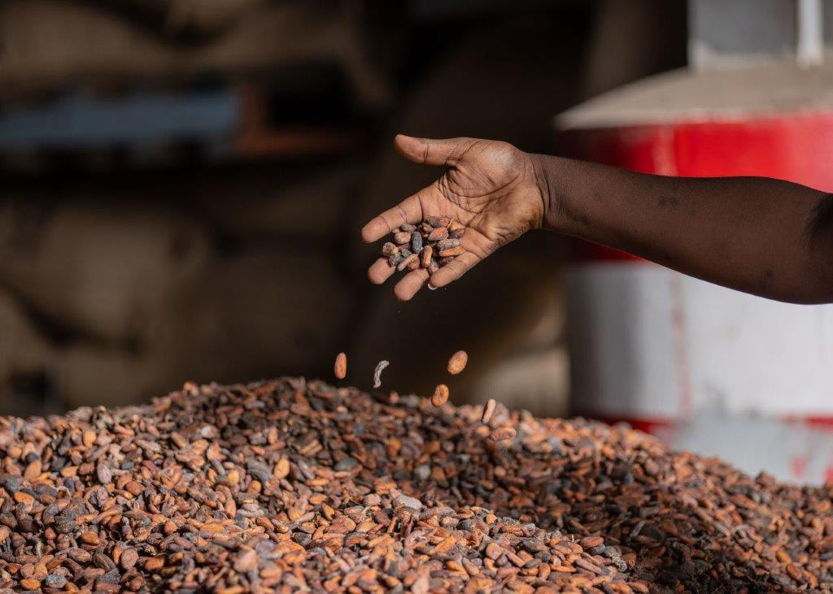
CAYAT
www.shared-interest.com
Notes:
Image shows dried cocoa beans
CAYAT is a cocoa and coffee farming co-operative, based around the towns of Adzopé and Yakassé-Attobrou in the South East of Ivory Coast. Like many areas across Ivory Coast, the La Mé region where CAYAT is located is home to many cocoa farmers who depend on the crop to earn a sustainable income.
CAYAT was founded by a group of farmers whose aim was to bring cocoa farmers together and address the region's deep socio-economic challenges, while advancing sustainable agriculture and increasing farmers' incomes. The co-operative started with 283 members and has since grown to over 3,300 members. Through their range of social impact projects, commitment to fair trade, environmental conservation and innovation, CAYAT have positioned themselves as a leader in the sector.
“We do everything to assure our producers that we can go far together.” Yao N’guettia, General Secretary of the Board of CAYAT
Awa Traoré has been the Director General of CAYAT since 2017. Awa is also a graduate of Fairtrade Africa’s Women’s School of Leadership (WSOL) established to support more women to take on leadership roles within their local economies and societies.
She told us: “We have demonstrated the important role women play in society. We have demonstrated that women must take a leading position in order to change things in our society.”
CAYAT became a customer of Shared Interest in 2016 with an Export Credit (COEC) facility to enable them to purchase cocoa beans from their members. This facility has been steadily increased in line with the growth of the business.
Awa said: “The first financial facilities were given when I first started at CAYAT and the support provided by Shared Interest was extremely helpful because in Côte d’Ivoire, the truth of the matter is that access to financial institutions is very difficult, especially for co-operatives.”

Slide 2
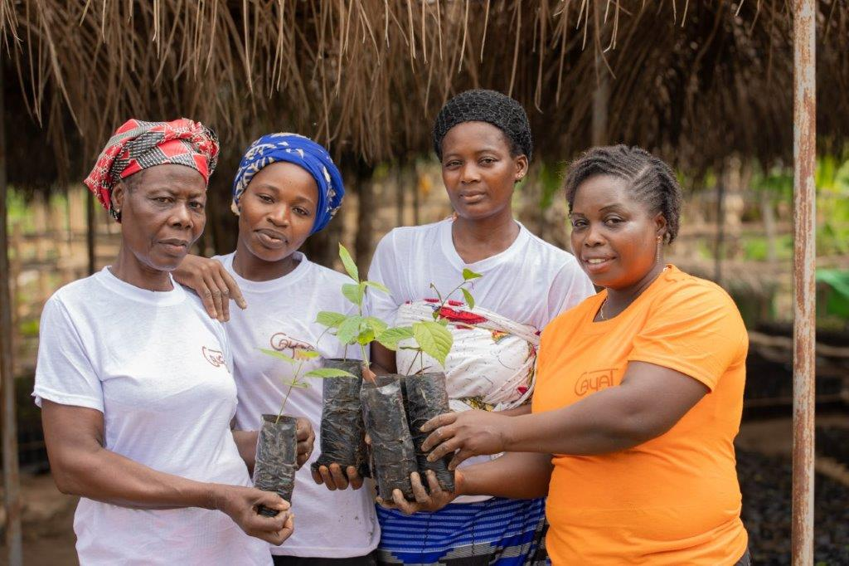
CAYAT
www.shared-interest.com
Notes:
Image shows Nursery Attendant, Rosine Ake Bekoin (right), and other nursery workers holding young shade trees
Rosine has been a cocoa farmer since 2000. She received two hectares of land from her grandmother to start her cocoa farm. Access to land is a great challenge for women living in the rural communities, especially land to grow cocoa, which is a long-term production crop.
Rosine was motivated by the support CAYAT could provide to her, which she described as: “first, a guaranteed market, but also training, quality improvement, premiums, and equipment”. Since joining CAYAT, Rosine has received training in Good Agricultural Practices, and participated in the Women School of Leadership, a programme coordinated by Fairtrade Africa and funded by Équité.
Rosine explained the impact of this training: “Many of us were illiterate but with the training offered by CAYAT, we can now read and write a little. Thanks to the CAYAT training, I now know how to save, engage in agricultural good practices, and help others.”
Rosine has also been able to increase her production from 250kg to 2MT. In addition to farming cocoa, Rosine also grows cassava, which she sells on the local market. She is also employed by CAYAT as a Nursery Attendant where, together with three other women, she oversees the development of the shade trees before they are distributed to the farmers.
Rosine’s ambition is to support the women at CAYAT to go into full-time agro-processing and value addition, she also wants to create a brand which is recognised across the whole country. Her personal ambition is to become a processor or even the director of a processing company.

